Slide 1
Review Credibility Capstone
Metin Senturk

Slide 2

Outline
Introduction
Literature Review
Process Flow
Models

Slide 3

Introduction
“Not every review is equally effective for potential customers”.
Fake reviews are problem and reduce the quality of life of the users.
Anderson and Magruber [1] show that in Yelp, an extra half star rating causes restaurants to sell out 19 percentage points (49%) more frequently.
[1] Michael Anderson and Jeremy Magruder. Learning from the crowd: Regression discontinuity estimates of the effects of an online review database. Economic Journal, 122(563):957–989, 2012.

Slide 4

Literature Review
Detecting Yelp Campains
User reviews in chronological order
Detected review spikes with user ratings (SpiDeR)
Review Spam Filtering
Review Bigrams, Embeddings of User, and Reviewed Product Together
Behavioral features and linguistic features
SVM 5 Fold CV
Reviews

Slide 5
Fake Detection Methodology
There are two commonly applied models: Supervised and Unsupervised.
Supervised with 5-fold CV
Mainly two features:
Behavioral features
Linguistic features

Slide 6





Dataset
6,685,900 reviews
192,609 businesses
200,000 pictures
10 metropolitan areas
1,223,094 tips by 1,637,138 users
Over 1.2 million business attributes like hours, parking, availability, and ambience
Aggregated check-ins over time for each of the 192,609 businesses

Slide 7
Features
Behavioral
Linguistic
Users:
Maximum Number of Reviews (MNR)
Percentage of Positive Reviews
Review Length
Reviewer Deviation
Maximum Content Similarity (using cosine similarity)
Time difference between Reviews
Average star given by User
Users:
Fans count
Friends count
Date joined
Average
Review count
User photo
Tips information

Slide 8
Features
Behavioral
Linguistic
Reviews
Has attachments (Photo, check-ins, etc.)
Reviews
Review length
Review star
Date of the review
Lexicality of content
Word count
Sentence count
And more..

Slide 9
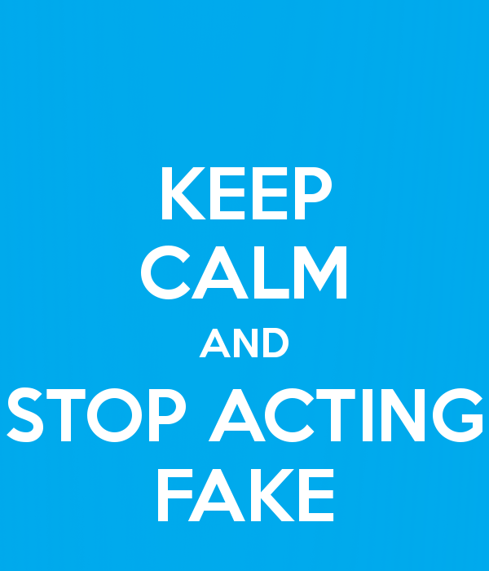
Thank You
Please feel free to ask questions or email me at msenturk@saintpeters.edu

